Slide 1
EDA and Price Predicting ML model for Mobile Phones
A Comprehensive Machine Learning Framework covering Advanced Feature Extraction, Label Encoding, EDA, and Feature Performance Analysis
Presented by: Govind Mishra

Slide 2

Executive Project Overview
Object:
The primary goal is to build a robust predictive model to estimate mobile phone prices based on hardware specifications, brand positioning, and engineered quality scores.
Key Deliverables:
Data cleaning of unstructured brand names.
Feature extraction for processors and colors.
Statistical univariate ,bivariate & Multivariate EDA.
Model training to predict phone price.

Slide 3
1. Executive Introduction & Data Cleaning
Dataset Scope:
Catalogs a range of mobile phone models with diverse specifications and price levels.
Dataset Inventry
Shape: 541 instances,11features
Quality: no null values
Data Cleaning Steps:
Deduped indexing artifacts and removed model duplicate entries to ensure catalog integrity.
Standardized manufacturer names (e.g. unifying brand casings and replacing aliases).
Renamed raw target column 'Prize' to standard 'Price' (INR) and converted strings to floats.

Slide 4
2. Feature Extraction & Engineering
Created composite variable Hardware_Score to represent device computing power.
Extracted Camera_Total_Megapixels by combining rear and front camera megapixels.
Created RAM_to_Memory_Ratio to detect specification configurations.
Spec Bins & Categorical Segments:
Segmented spec variables into standard categories (RAM_Category, Memory_Category, Battery_Category) to facilitate cross-spec pricing analysis.
Feature | Formula | Purpose
Hardware_Score | Memory * RAM * (Battery / 1000) | Combined hardware level
Camera_Total | Rear_Camera + Front_Camera | Imaging capability index
RAM_to_Mem_Ratio | RAM / Memory | Spec balancing index
Memory_Category | Binned Memory | Discrete storage levels
RAM_Category | Binned RAM | Discrete memory tiers

Slide 5
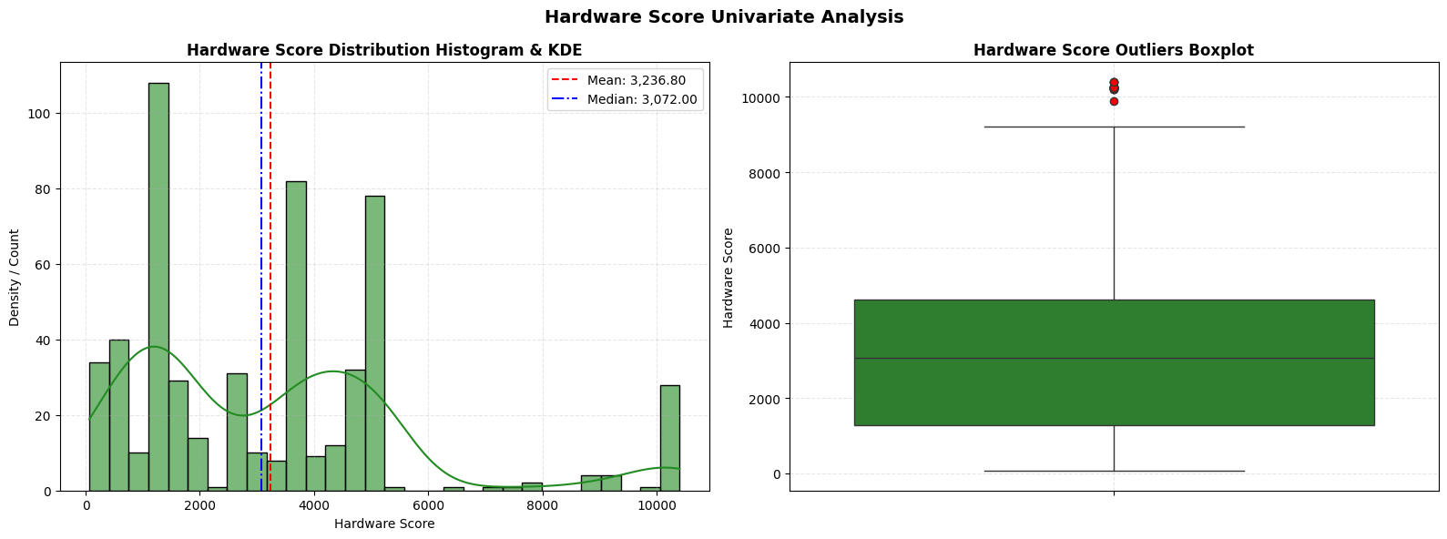
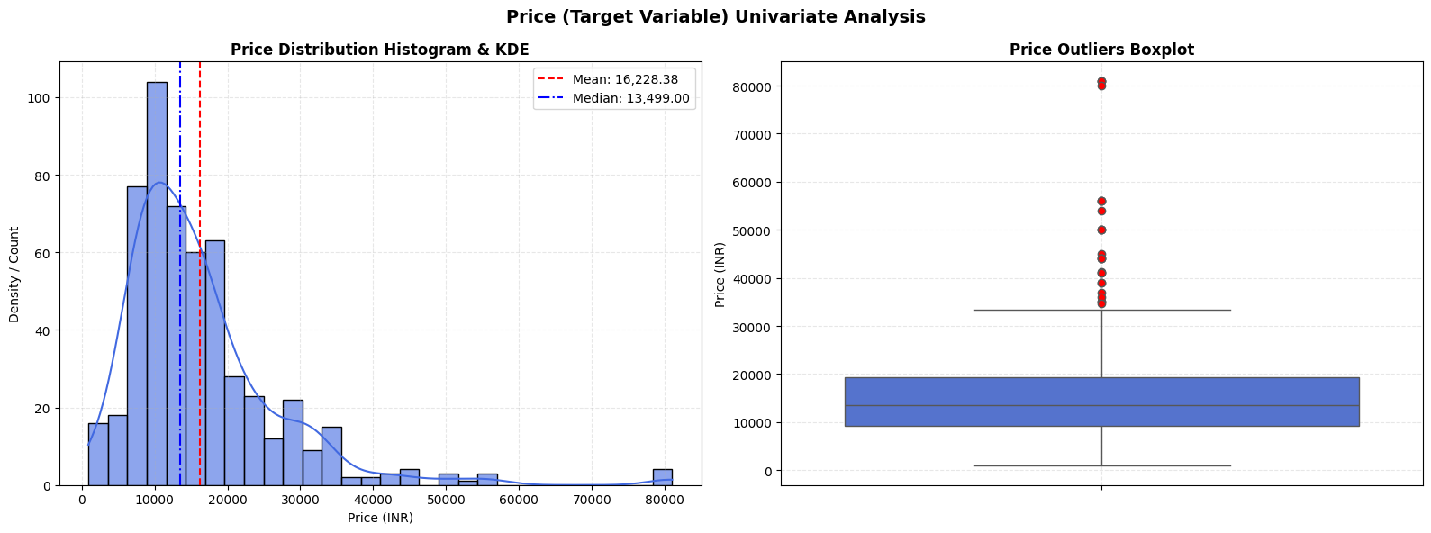
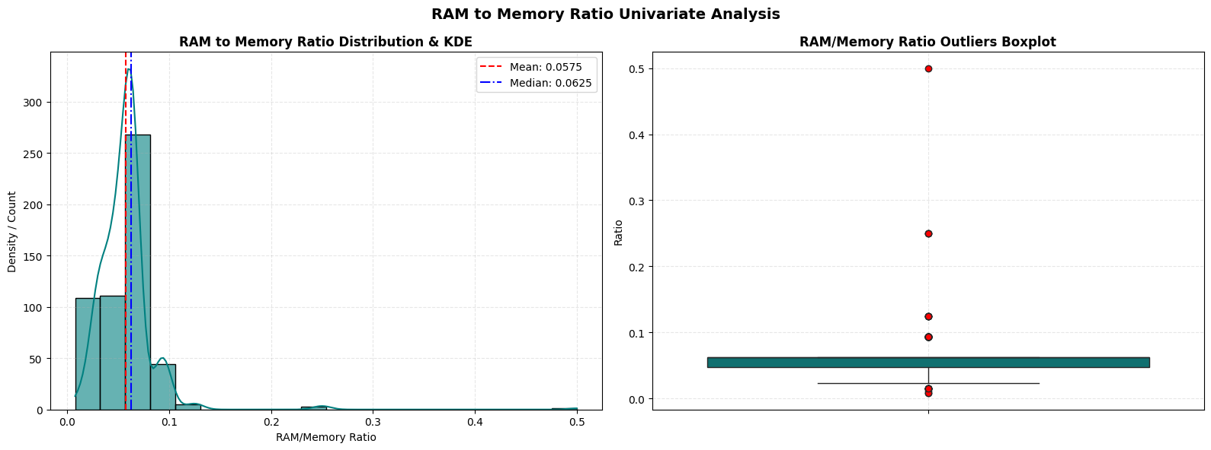
3. Univariate Analysis Insights
Numeric Features
Hardware Score Distribution:
Hardware scores average 3,237 (median 3,072), show right skew (1.18) toward high‑performance
Outliers: 29 flagships score >7,500 (max RAM/storage/battery).
Price distribution:
Prices average ₹16,228 (median ₹13,499), show strong right skew (2.43, kurtosis 9.61) with 25 premium outliers above ₹33K (e.g., Galaxy S23)
RAM to Memory Ratio Insights:
Memory ratios Avg/median 0.06, extremely skewed (7.22, kurtosis 91.13) by legacy setups, with 64 outliers at 0.12–0.25 from low‑storage/high‑RAM mismatches.”

Slide 6
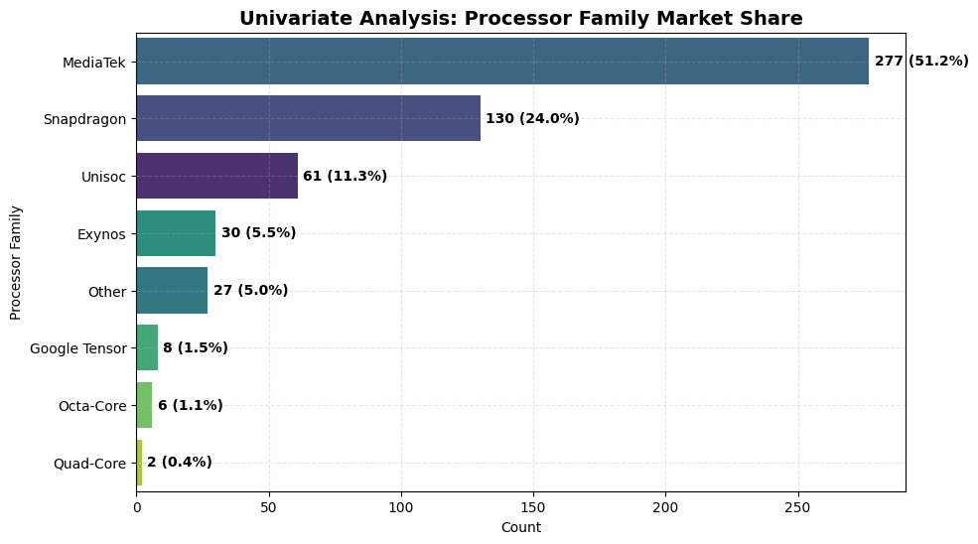
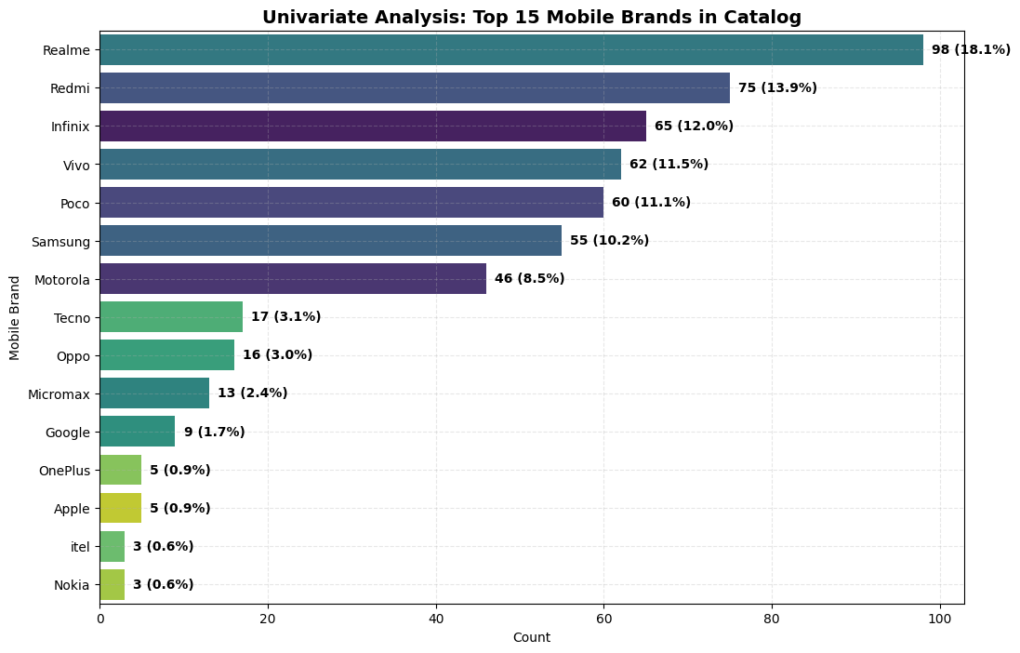
3. Univariate Analysis Insights
Categorical feature:
Processors: MediaTek leads (49.4%); Qualcomm second (mid/high mix).
Colors: Black (31.2%) and Blue (29.8%) hold 60%+ market share.
RAM: Mainstream 4–6GB (34.4%), premium 8–12GB (29.0%), budget ≤4GB (14.2%).
Storage: 64–256GB is mainstream; 256GB+ is for premium tier.
Brands: Top 7 brands control 86.1% (Realme 18.1%, Redmi 13.9%, Infinix 12.0%).

Slide 7
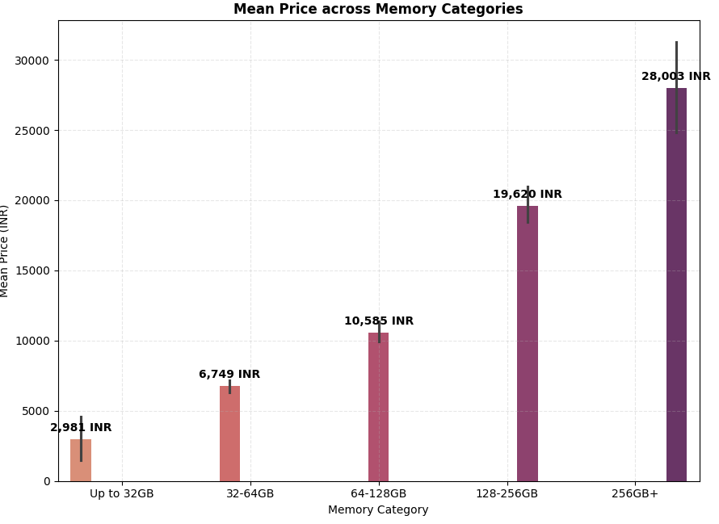
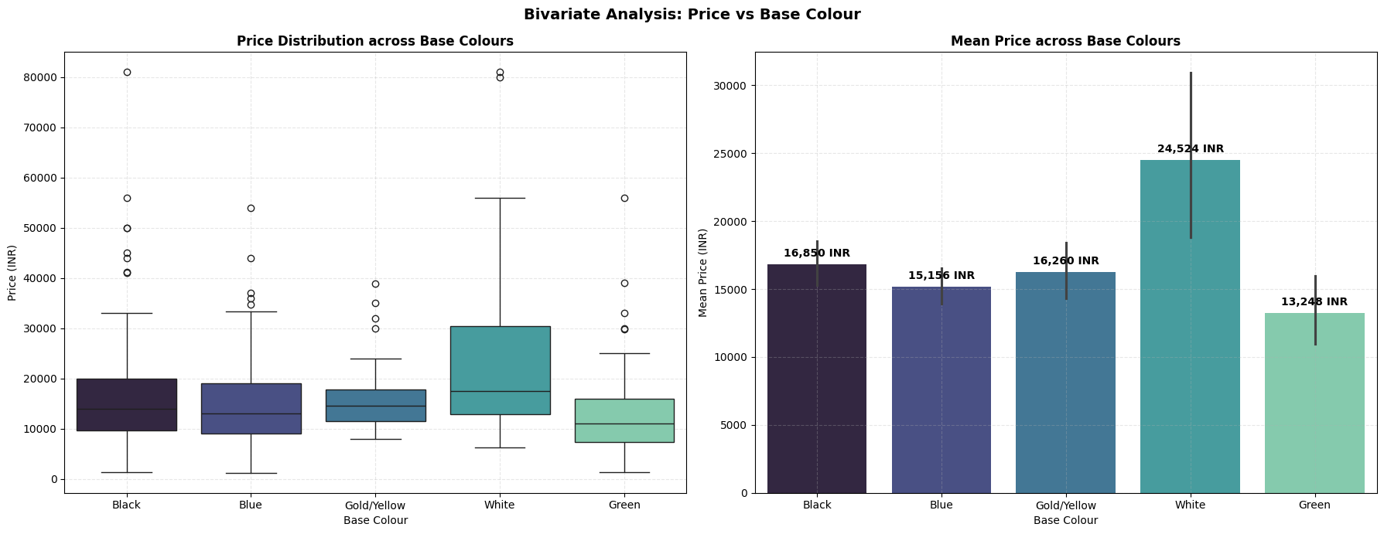
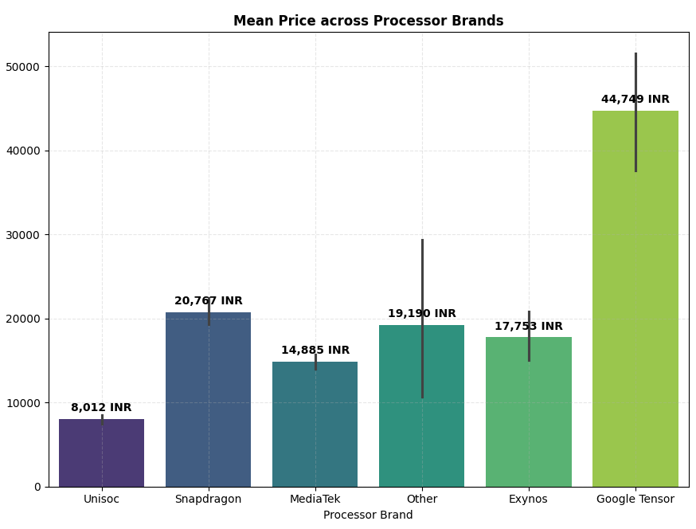
4. Bivariate Analysis Insights Categorical Features
Storage drives price tiers ≤32GB stays under ₹7.5K, 32–64GB hovers near ₹11K, while 256GB+ leaps to ~₹29.4K premium.
Processor tiers — Apple (~₹80K) & Tensor at premium, Snapdragon (~₹21K) & Exynos mid‑high, MediaTek (~₹14K) entry/mid, Unisoc budget (~₹7.6K).
RAM tiers — ≤4GB ~₹8.3K, 4–6GB ~₹13.4K, 8–12GB premium ~₹26.4K with widest spread across mid‑range & flagship models.
Colour tiers — White (~₹24.5K) signals premium flagships, Black (~₹16.9K) & Gold (~₹16.3K) form mid‑range core, while Blue (~₹15.2K) & Green (~₹13.2K) anchor entry‑level devices.

Slide 8
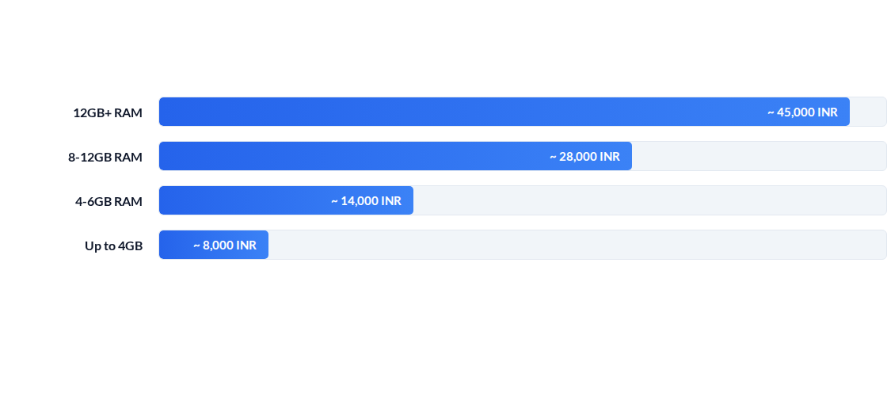
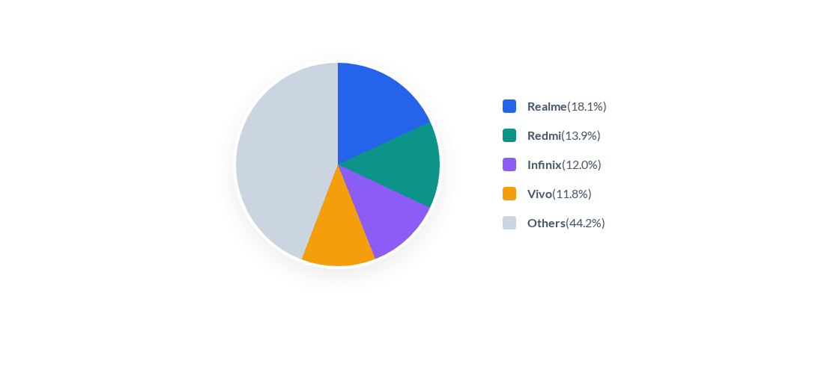
Market share : Dominant brand
Price vs RAM Specs
The market landscape is highly concentrated: four major value-focused brands control more than 55% of the catalog, highlighting intense pricing pressure within the budget tiers.
Our specifications scaling analysis confirms that hardware configurations are the strongest predictor of retail value. RAM tier exhibits a powerful correlation coefficient of r = 0.56 with final price.

Slide 9
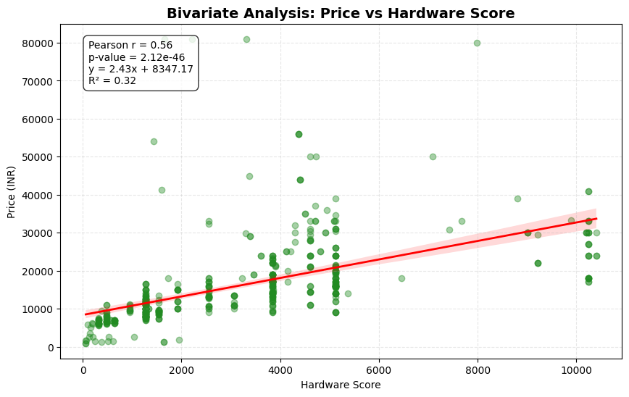
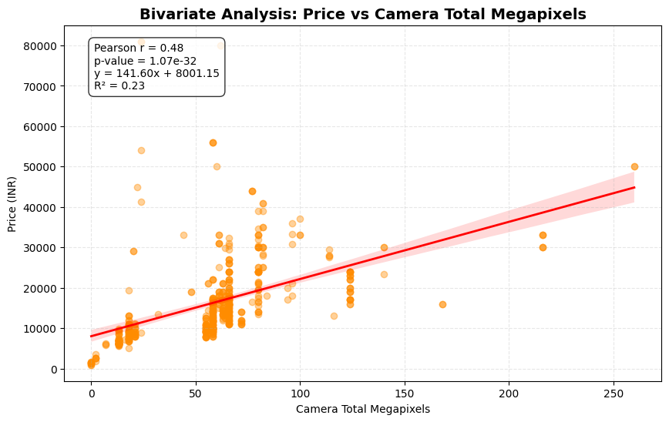
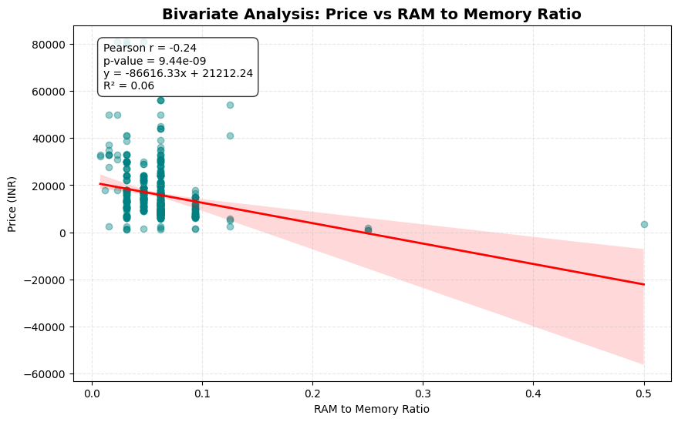
4. Bivariate Analysis : Numeric Features
Correlation Analysis against Target Price (INR):
Hardware Score (r = 0.56): The strongest numeric correlation with Price, confirming hardware scaling drives pricing.
Camera Total Megapixels (r = 0.48): Holds a strong positive linear relationship with retail price.
Mobile Height (r = -0.06): Displays near-zero correlation, indicating standard height formats (~16.68 cm) do not command a premium.
RAM-to-Memory Ratio (r = 0.04): Very weak correlation, confirming that structural ratio imbalance does not dictate retail value.

Slide 10
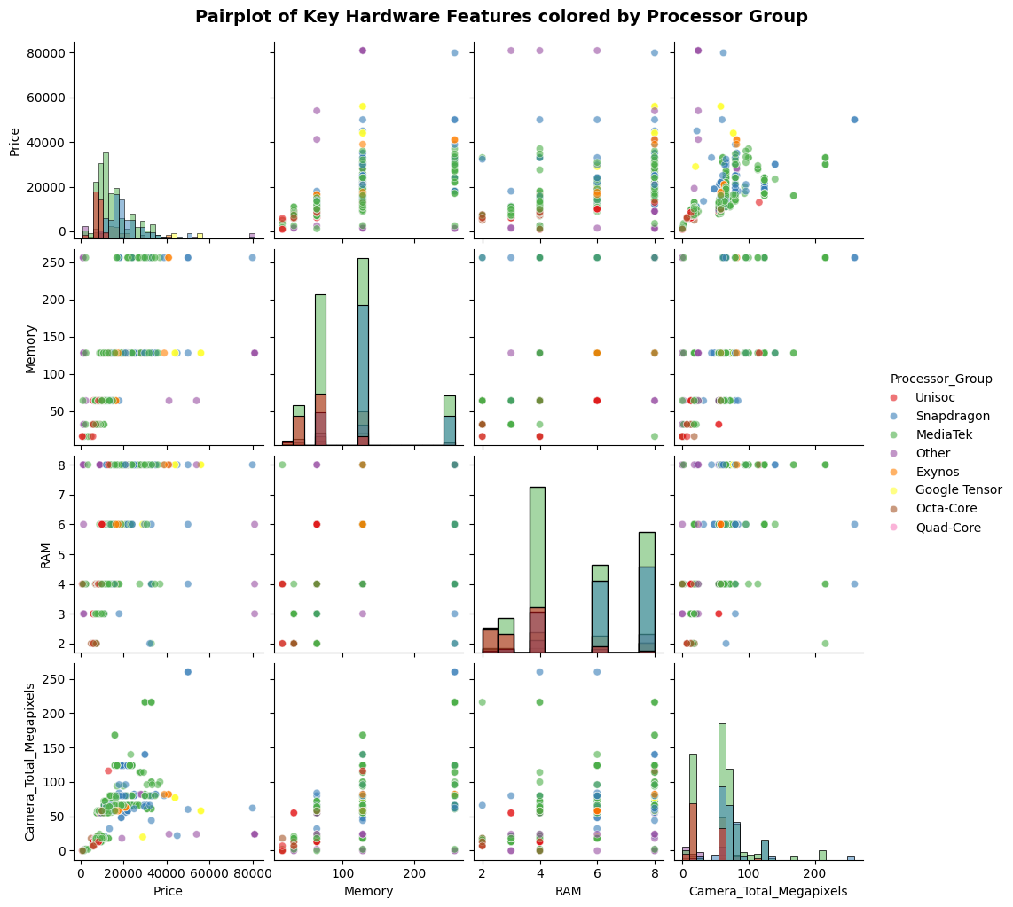
5. Multivariate Analytical insight :
The Flagship Bundle (Core Drivers): Hardware_Score (0.56) and Camera_Megapixels (0.48) are the primary price drivers. Manufacturers strictly package high-end CPUs with premium sensors (0.53 correlation) to form "prestige tiers."
Silicon Stratification: Chipset choices define market boundaries. Unisoc is locked in the entry-level corner; Snapdragon/MediaTek span all tiers; Apple/Google Tensor anchor the premium high-margin sector
Symmetric Configurations: Product configurations are highly balanced. "Unbalanced" builds (e.g., high RAM with low storage) do not exist in the market.
The Price Floor & Premium Steps: Specs place a strict lower bound on cost—zero high-spec devices exist at low prices. Upgrading tiers yields exponential price jumps, moving from a standard 4-6GB/64-128GB build (∼13.4k INR) to a premium 8-12GB/256GB+ model (∼50k+ INR).

Slide 11
6. Outlier Handling: IQR Winsorization
Outlier Capping Strategy:
Mobile prices contain extreme outliers (flagship models) that can skew model convergence.
Applied IQR Winsorization: capped values outside Q1 - 1.5*IQR and Q3 + 1.5*IQR.
Winsorization applied to Price, Hardware_Score, and Camera_Total_Megapixels.
Benefits:
Prevents extreme outliers from dictating mean predictions.
Stabilizes variance across numeric specifications for more robust cross-validation.
Metric (Original vs Capped) | Mean | Std Dev | Min | Max
Price (Original) | 16,228.38 | 10,793.59 | 920.0 | 80,999.00
Price (Capped) | 15,499.80 | 8,234.75 | 920.0 | 34,265.00
Hardware_Score (Orig) | 3,236.80 | 2,492.04 | 64.0 | 10,403.84
Hardware_Score (Cap) | 3,202.45 | 2,397.66 | 64.0 | 9,600.00
Camera_Total (Orig) | 58.10 MP | 36.68 MP | 0.0 MP | 260.00 MP
Camera_Total (Cap) | 56.56 MP | 31.14 MP | 0.0 MP | 133.50 MP

Slide 12
7. Categorical Feature L Label Encoding Encoding
Encoding & Dimensionality Setup:
Formatted categorical columns into numerical labels to make them compatible with regression algorithms.
Applied LabelEncoder to: Model_name, processor, base_colour, RAM_Category, Memory_Category.
Data Representation:
Label encoding retains discrete ordinal patterns without expanding feature dimensions (unlike One-Hot Encoding which adds 50+ columns for brand/model names).
Fully encoded numerical data to train model.
Original Category | Encoded column | Discrete Labels
Model_name | Model_name_Encoded | 10+ Unique Brands
processor | processor_Encoded | 15+ Unique Chipsets
RAM_Category | RAM_Category_Encoded | 5 Bins
Memory_Category | Memory_Category_Encoded | 5 Bins
base_colour | base_colour_Encoded | 20+ Unique Colours

Slide 13
Model Performance Comparison (Cross-Validation vs Test Holdout)
Model | CV Mean MAE | CV Mean RMSE | CV Mean R² | Test MAE | Test RMSE | Test R² Score
Linear Regression | 4,479.14 | 7,201.01 | 0.5199 | 4,343.70 | 8,881.19 | 0.5262
Ridge Regression | 4,387.92 | 7,053.56 | 0.5434 | 4,390.12 | 8,059.63 | 0.5287
Random Forest Regressor | 2,346.36 | 4,850.71 | 0.7761 | 1,838.04 | 5,126.57 | 0.8093
Gradient Boosting Regressor | 2,429.60 | 4,913.11 | 0.7668 | 2,055.62 | 5,049.80 | 0.8150

Slide 14
8. Machine Learning Modeling & Price Prediction
Pipeline Setup
Preprocessed numeric features → ML models
Strict validation for robustness
Validation Protocol
80/20 train–test split
5‑fold cross‑validation (KFold, seed=42)
No leakage (scaling/encoding isolated)
Evaluation Metrics
MAE → Avg error (₹)
RMSE → Penalizes large errors
R² → % variance explained
Insights:
Model Performance
Random Forest & Gradient Boosting → R² > 0.80, strong predictive accuracy
Capture complex, non‑linear pricing patterns
Linear Regression → R² ~0.52, confirms pricing depends on multi‑spec thresholds

Slide 15
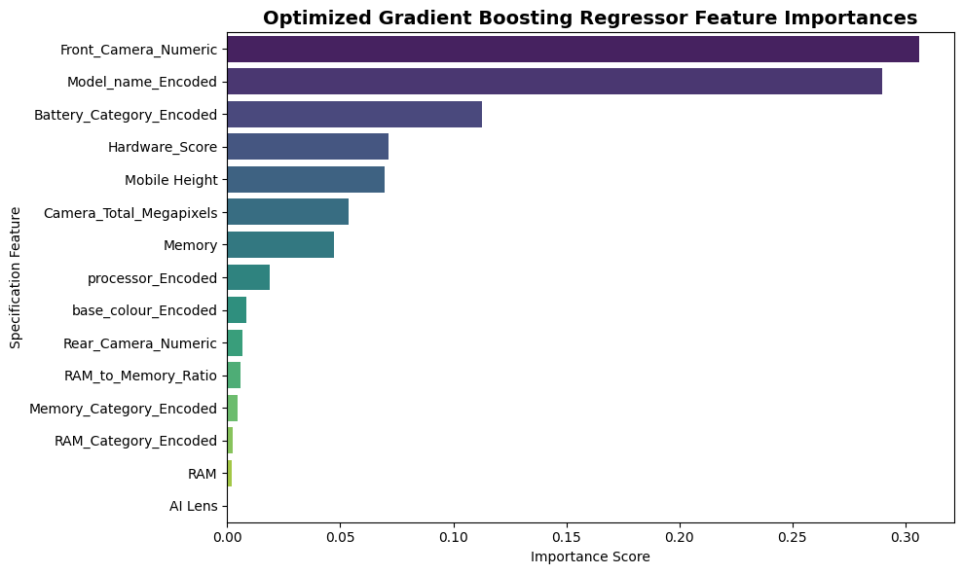
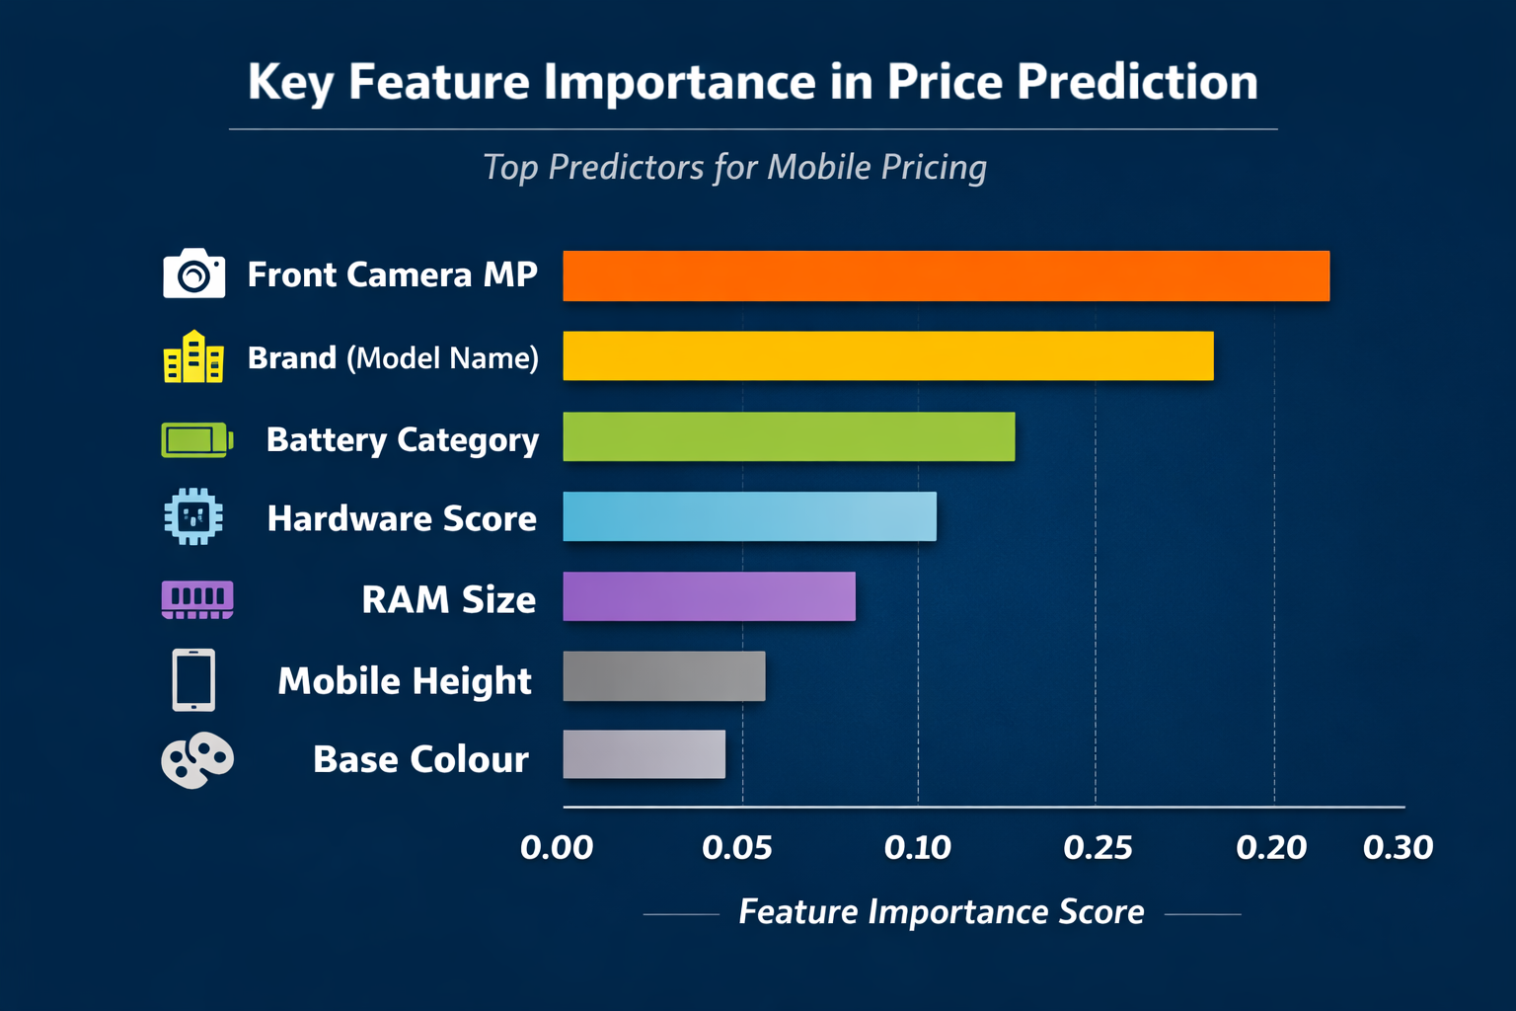
Key Spec Drivers (Feature Importance)
Front Camera MP & Brand → Primary drivers, strongest influence on price
Battery Category & Hardware Score → Secondary tier, highlight efficiency & battery specs as differentiators
Height & Base Colour → Minimal impact, commoditized features
Takeaway
Non‑linear ensemble models best capture mobile pricing dynamics
Camera quality, brand, and efficiency specs drive value perception

Slide 16
9. Summary & Conclusions:
Market Profile:
56.9% of inventory priced < ₹15K → strong tilt toward budget segment
Indicates high price sensitivity among majority of customers
Price Drivers:
Hardware Score (r = 0.56) → most influential, performance specs drive value
Camera Specs (r = 0.48) → secondary driver, imaging quality matters
Screen Height (r = 0.18) → weak correlation, commoditized feature
Discounting Trend
Imbalanced RAM–Memory setups (high RAM, low storage) → discounted by buyers (r = –0.24)
Customers penalize bottlenecked configurations
Brand Value Concentration
Realme, Vivo, Redmi → 42.5% of total value, dominate mid‑range
Samsung → 13% value vs 10% volume → premium perception
Apple → 3.9% value with <1% volume → niche but high‑value positioning

Slide 17
10.Future Strategies to Boost Sales
1.Balanced Hardware Configurations
Insight: Mismatched specs (e.g., 6GB RAM + 32GB storage) frustrate buyers and reduce value.
Strategy: Scale RAM and storage proportionally (6GB/128GB, 8GB/256GB) to elevate perceived value and boost ASPs.
2.Mid-Tier Camera Differentiation
Insight: High megapixels drive premium pricing, but most mid-tier competitors lag in camera specs.
Strategy: Equip mid-range phones (₹12K–₹20K) with high-end sensors (e.g., 108MP) to maximize margins without costly CPU upgrades.
3. Premium Aesthetic Styling
Insight: Color impacts pricing; White leads ASPs at ₹24,524, aligned with flagship models (Samsung, Pixel).
Strategy: Introduce flagship colors (White, Matte Black) in mid-tier models to charge a psychological “color premium” at zero hardware cost.
4. Bundles for the Budget Core
Insight: The under-₹15K segment is hyper-saturated, making up 56.9% of the catalog.
Strategy: Differentiate by bundling budget phones with fast chargers, premium cases, or screen warranties instead of cutting prices.

Slide 18
THANK YOU !

